Slide 1
PHOTO ESSAY
Dean Matthew Lumayor
Yuan Carlos Raflores
8 – Marignano

Slide 2

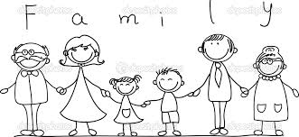

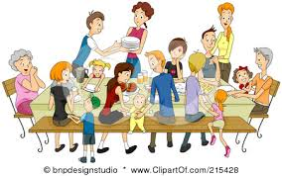
Family, The people who understands you the most. The people who care for you everyday.
People who love you from since you were born, the people who make you feel home. Where you go home to everyday after school.
For me family is one of the most important people that you can have in your life. That’s why I, myself, loves my family so much because they support me in everything I do, help me in all of my Problems, and always being there for me.
THE LOVE OF A FAMILY IS LIFE’S
GREATEST BLESSING.

Slide 3




Ambition, what makes people great, and great people greater. People’s dream is what makes them strive for more, more achievements and milestones, and what ever else that makes them feel accomplished. What do they do?, they AIM HIGH they don’t settle for the regular, they set their minds to be special. Personally, my dreams are to finish school, get a job that I like and accomplish things that I like when I was young. I want to live a life that is well lived because there is a difference between achieving a dream and having fun while doing it ;)

Slide 4



Nature is a beautiful thing in the world. The green lime grass, the beautiful clear blue lakes. This is our planets art that no one can ever bring back. God’s perfect artwork, that any artist cannot do. The beauty of colorful birds, majestic beasts and fishes. These are all Gods work that all adore and love.

Slide 5

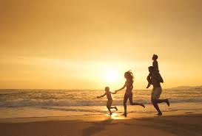

Family, a family is like a team that all stays together and never leaves anyone behind. The father who is the leader, is the one that is in charge of the whole family and leads them into a perfect life. The mother is the light of the family. And of course the children is the family’s main priority, they make their parents happy and most especially they respect their parents.

Slide 6
THANK YOU FOR LISTENING!

